Slide 1
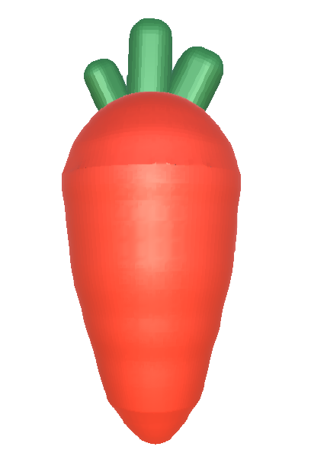
Overview
1. Prepare you dataset
2. Train the Keypoint Detection Model
3. Deploy pre-trained model to make avatar dance

Slide 2
1 Prepare you dataset
1.1 Photo taking
1.2 Data(Photo) Labelling

Slide 3
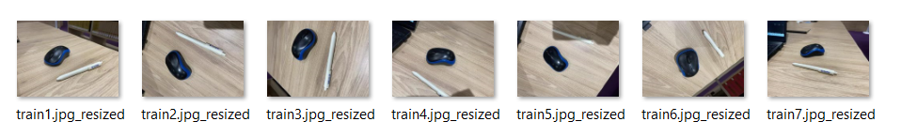
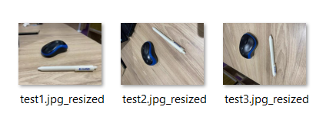
1.1 Photo taking
Take 20 photos of any keypoint/object you want to detect
And more…

Slide 4
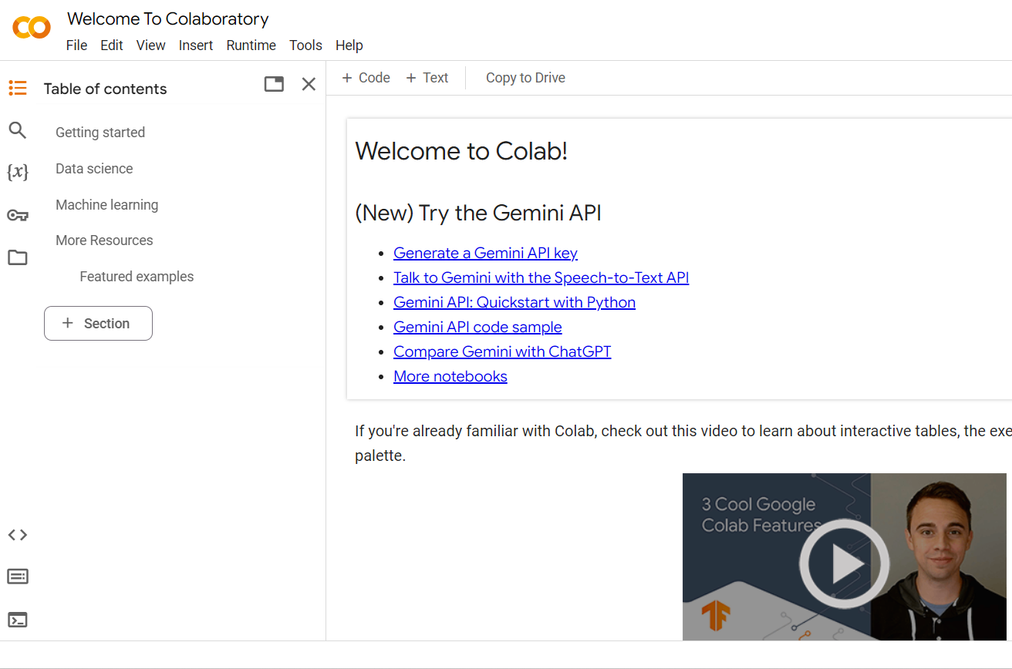
1.2 Data(Photo) Labelling
Open Google Colab:
https://colab.research.google.com/

Slide 5
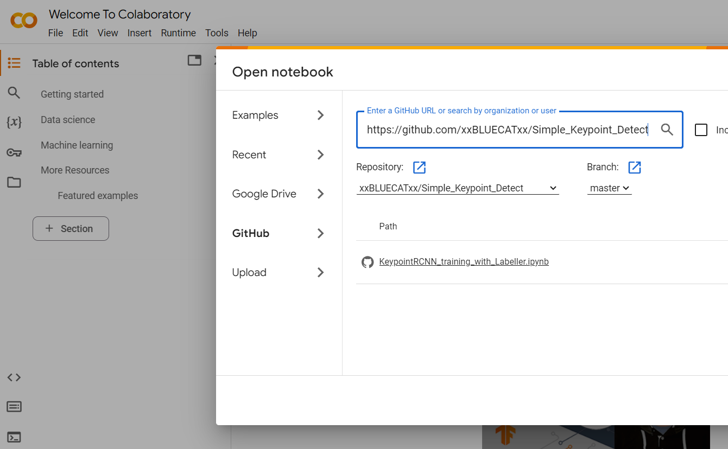
1.2 Data(Photo) Labelling
Click File -> Open Notebook-> GitHub:
Enter the project link and search:
https://github.com/xxBLUECATxx/Simple_Keypoint_Detect
Open the .ipynb notebook file

Slide 6
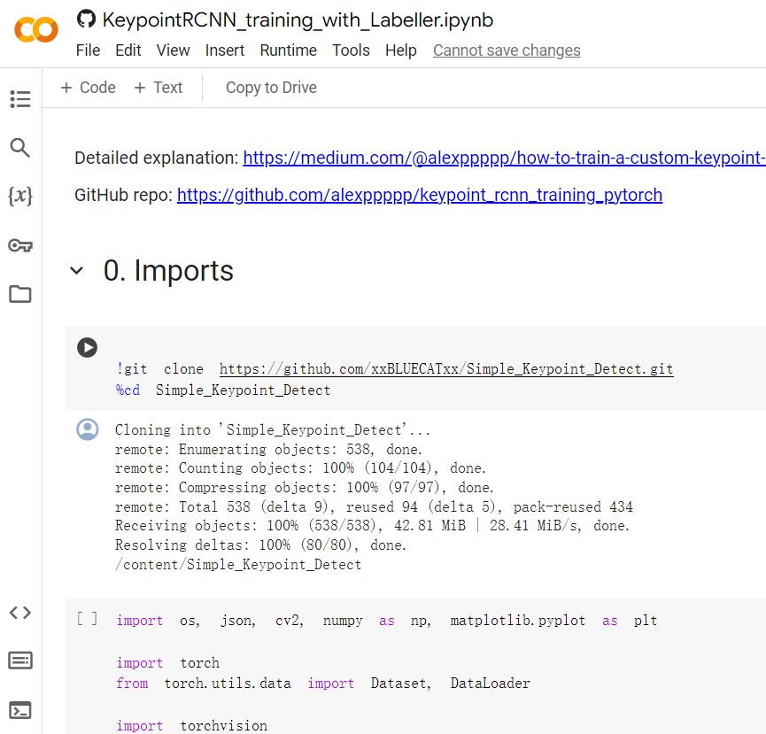
1.2 Data(Photo) Labelling
Run the first 3 cells to install packages and files needed

Slide 7
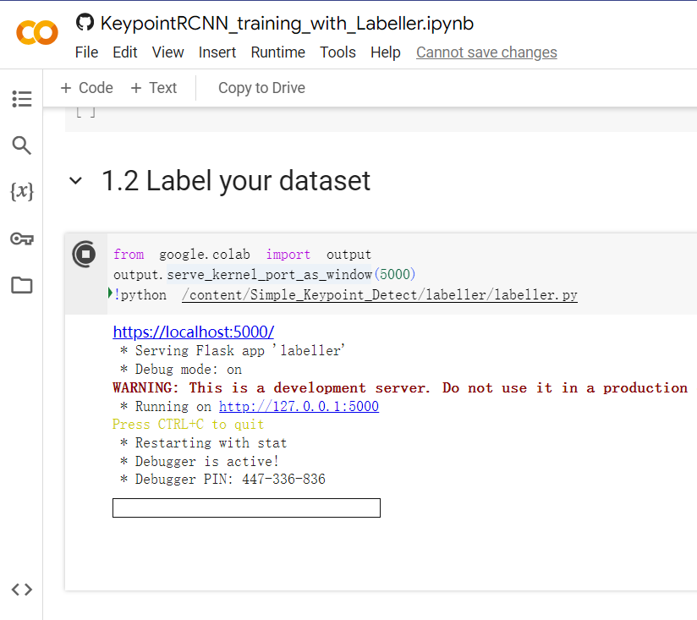
1.2 Data(Photo) Labelling
Run the Labeller cell, you should see a link to the labelling user interface, click on it.
You will see 2 links generated, click on the first one

Slide 8
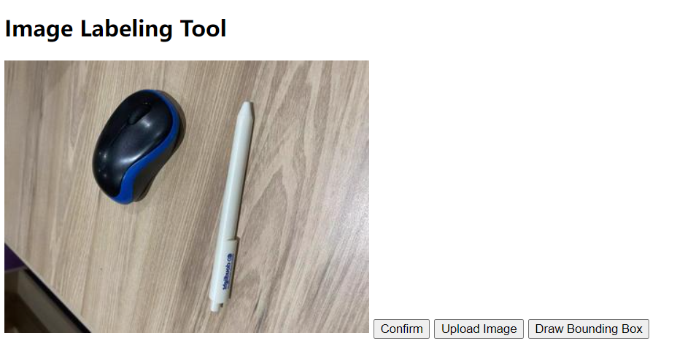
1.2 Data(Photo) Labelling
In the labeler, firstly click on Upload Image
Select the photo token, we will process them one by one.

Slide 9

1.2 Data(Photo) Labelling
Click Draw Bounding Box, you should see the cursor becomes a ‘plus’ sign(+) when it is on the photo.
Hold and drag your left click to draw the box.

Slide 10
1.2 Data(Photo) Labelling
Run the Labeller cell, you should see a link to the labelling user interface, click on it.
You will see 2 links generated, click on the first one

Slide 11
1.2 Data(Photo) Labelling
In the labeller, firstly click on the ‘draw boundary box’ button
Image a box that can include your object completely, left click on the left-bottom point of the box and drag it to the right-top point of the box, release your left click, you should see a boundary box on the image.

Slide 12
1.2 Data(Photo) Labelling
Next, click on the first keypoint you want to label, a red dot will be marked on the keypoint.
Click on the second keypoint you want to label, a blue dot will be marked on it.

Slide 13
1.2 Data(Photo) Labelling
You should now have a boundary box and two dots on your image, click confirm, a JSON file stores the label will be downloaded to your computer

Slide 14
1.2 Data(Photo) Labelling
You should now have a boundary box and two dots on your image, click confirm, a JSON file stores the label will be downloaded to your computer
Label all your pictures
Place the JSON files into my_set/train/annotations or my_set/test/annotations correspondingly

Slide 15
Overview
1. Prepare you dataset
2. Train the Keypoint Detection Model
3. Deploy exist model to make avatar dance

Slide 16
2. Train the Keypoint Detection Model
Run the remaining cells in Colab, you should be able to train the model with your own dataset and see the result.

Slide 17
2. Train the Keypoint Detection Model
The results may not be ideal, there are a few things you may do to increase the accuracy.
Go back to the training step, change the number of epoch/learning rate/step size, see the effect with larger/smaller numbers.
Increase the size of your dataset
Increase the quality of your dataset

Slide 18
3. Deploy existing model to make avatar dance
I will leave it here first, mainly following the workflow of the readme.md in the repo we use

